Slide 1
A Bad Thing Has Happen
Now What
Your Benefits and what to do

Slide 2
DISCLAIMER
The Information being presented is for informational purposes
It is not official information from any entity
It is accurate to the best of the presenter knowledge at time of creation

Slide 3
Things to Think Of Doing
If eligible enroll in VA Healthcare
  Federal Benefits for Veterans, Dependents Survivors and Caregivers
  No Matter your rating get established if possible.
  50% Service connection or greater Priority Group 1 all health issues covered and medication.
Complete a Guide Like one Linked Below for when you are gone. Do this regardless of status of VA disability.
  The Paper Safe
  Have a copy of the DD214 with the above booklet or like information
  If you have Prepaid your burial have the receipts available with the above document
Take time and record your time in service on paper
  Unit assignments, Bases you spent time at. If you have dold travel orders save the. These can be used for claims after death like issues with Camp Lejeune Water Future sites of Agent Orange Exposure.

Slide 4
Things to Think Of Doing
If you already have a plot for your burial review with your loved ones your wishes after death. Think of what you would like on your headstone. See attached link below for link to application for examples of what are available to all veterans.
  Headstones - About VA Form VA40-1330 | Veterans Affairs

Slide 5
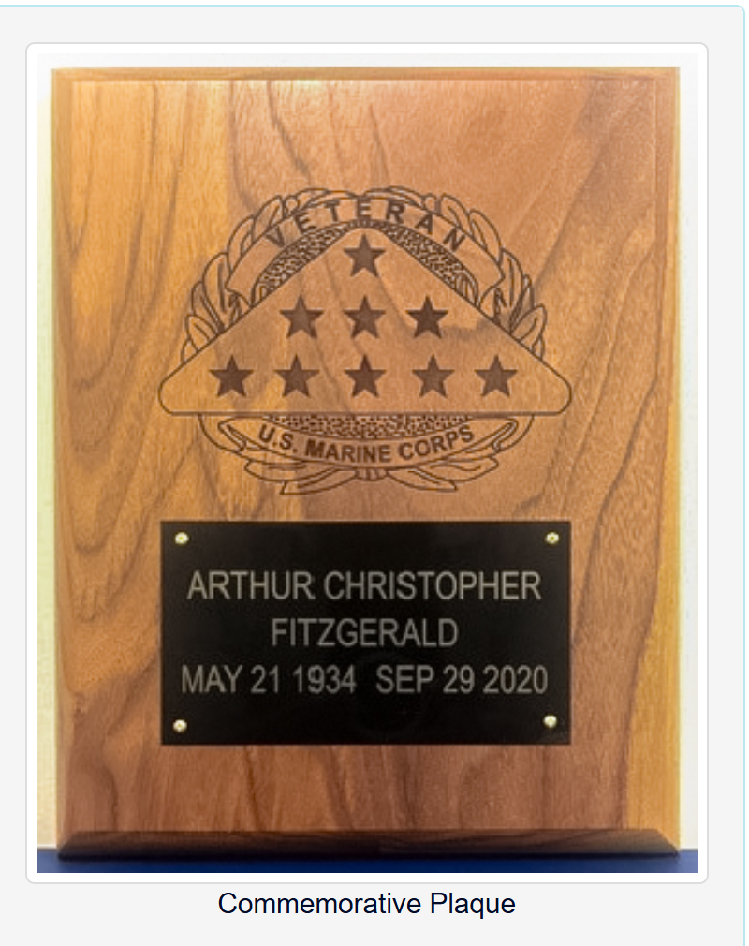
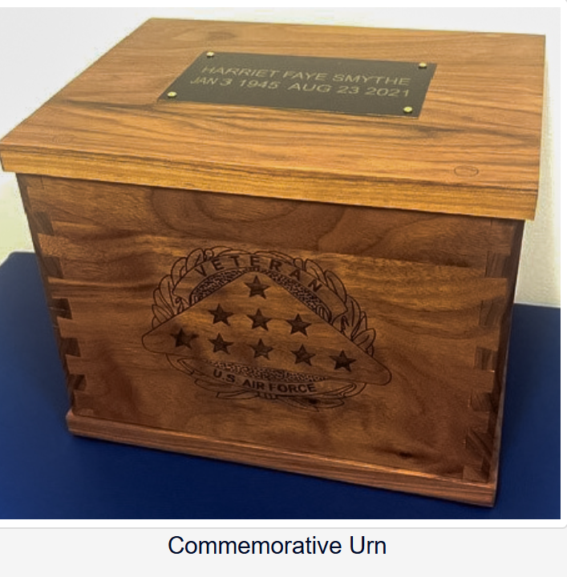
Things to Think Of Doing Burial
Urn
Commemorative Urn and Plaque - National Cemetery Administration
Commemorative Plaques

Slide 6
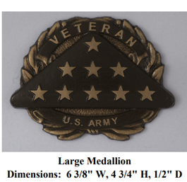
Things to Think Of Doing
Medallions for private head stones

Slide 7
You Have an Accident Now What
If you are above 50% Service connected and established with VA Healthcare
After getting treatment you have 72 hours to report the hospitalization or care to 1 844-724-7842
This will get VA Healthcare involved for payment of the bills.
Note with VA covering the bills if there is a settlement you may have to pay VA back.

Slide 8
After You Have Passed
The Widow or Widower needs to notify VA immediately at
1-800-827- 1000 or calling your Veteran service officer.
Schedule an appointment with a Veteran Service Officer to apply for benefits.
NOTE YOUR COMPENSATION PAYMENT WILL STOP IMMEDIATELY !
It can take up to a year to get any compensation restarted there will be a disruption in income until all claims are completed Prepare now!
Gather :
  DD214
  Death Certificate
    If died from an issue not already service-connected at least have facility where treated and when. As the VSO may file for Service connected death under a presumptive condition.
  Paid Itemized Burial Receipt
  Current voided Check for direct deposit of funds (will need be submitted as the widow is the the new claimant)

Slide 9
After You Have Passed
If you have completed the paper safe in the earlier part of the presentation, bring that in.
If you have made decisions for VA provided headstones as noted in the Things to Think of Doing bring in that information
If you are not drawing disability for a service-connected issue or if the issues you are serviced service-connected were not contributing factors to your passing VA compensation will still pay an allowance of 978.00 to towards burial expenses and Plot Allowance of 978.00 for a nonservice connected death.

Slide 10
After You Passed
Your Spouse maybe Eligible for Dependent Indemnity Compensation.
If you pass away from your service-connected injuries and they are listed on the death certificate as cause of or contributing factor to your death.
2025 rate is 1653.06
If you had a VA disability rating of totally disabling (including for individual unemployability) for at least the 8 full years leading up to their death, and
You were married to the Veteran for those same 8 years there is a and additional 8-year provision of 351.02

